Slide 1
Week 2 Development 6a - Algoritmiek
INFDEV016A
Giulia Costantini
costg@hr.nl – Office H4.204

Slide 2
Today
Why is my code slow?
Empirical and complexity analysis
How do I order my data?
Sorting algorithms
How do I structure my data?
Linear, tabular, recursive data structures
How do I represent relationship networks?
Graphs

Slide 3
Sorting algorithms
Insertion sort, Merge sort
http://www.youtube.com/watch?v=INHF_5RIxTE

Slide 4
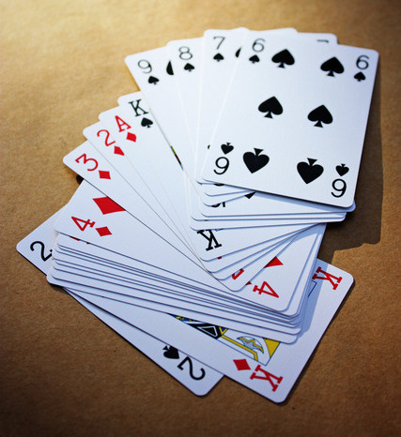

Sorting algorithms
Algorithms that put elements of a list in a certain order (numerical/lexicographical)
fundamental problem in computer science
as a standalone algorithm (i.e., producing human readable output)
as part of more complex algorithms which require sorted data (i.e., binary search!)
usually, data is considered to be stored in an array

Slide 5
Sorting algorithms
Popular sorting algorithms
Simple sorts
Insertion sort, selection sort
Efficient sorts
Merge sort, Quick sort, Heap sort
Bubble sort and variants
Bubble sort, Shell sort, Comb sort
Distribution sort
Counting sort, Bucket sort, Radix sort
In practice, a few algorithms predominate
Notes:
In practical implementations a few algorithms predominate. Insertion sort is widely used for small data sets, while for large data sets an asymptotically efficient sort is used, primarily heap sort, merge sort, or quicksort (the overhead of these algorithms becomes significant on smaller data; the algorithms often perform poorly on already sorted data or almost sorted data; they may also be unstable).

Slide 6
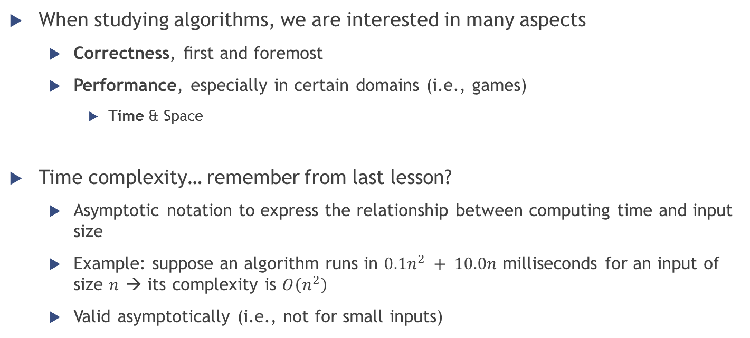
Sorting algorithms
When studying algorithms, we are interested in many aspects
Correctness, ﬁrst and foremost
Performance, especially in certain domains (i.e., games)
Time & Space
Time complexity… remember from last lesson?
Asymptotic notation to express the relationship between computing time and input size
Example: suppose an algorithm runs in $0.1n^{2} + 10.0n$ milliseconds for an input of size $n$ → its complexity is $O\left(n^{2}\right)$
Valid asymptotically (i.e., not for small inputs)

Slide 7
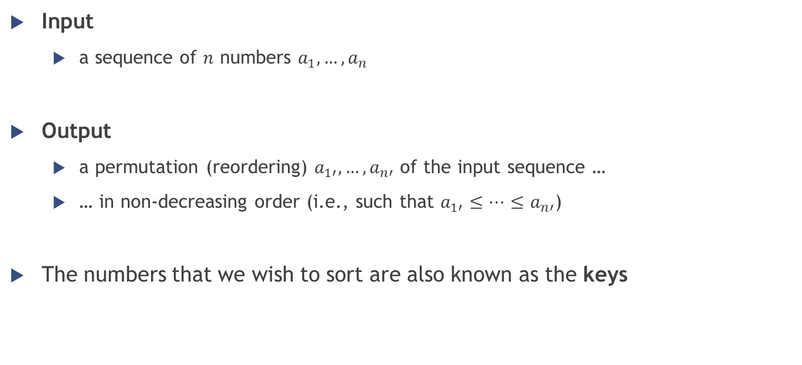
Sorting algorithms
Input
a sequence of $n$ numbers $a_{1},…,a_{n}$
Output
a permutation (reordering) $a_{1′},…,a_{n′}$ of the input sequence …
… in non-decreasing order (i.e., such that $a_{1′}≤…≤a_{n′}$)
The numbers that we wish to sort are also known as the keys

Slide 8
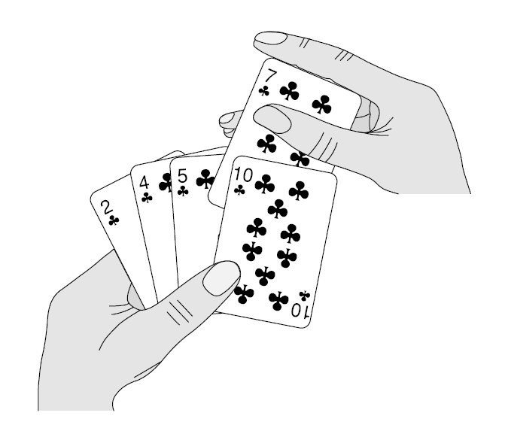

Insertion sort

Slide 9
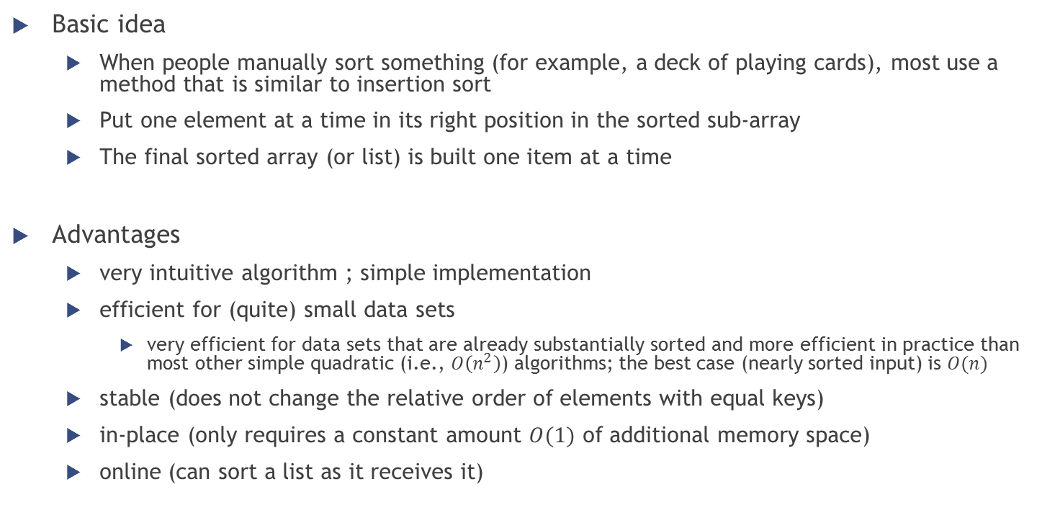
Insertion sort
Basic idea
When people manually sort something (for example, a deck of playing cards), most use a method that is similar to insertion sort
Put one element at a time in its right position in the sorted sub-array
The final sorted array (or list) is built one item at a time
Advantages
very intuitive algorithm ; simple implementation
efficient for (quite) small data sets
very efficient for data sets that are already substantially sorted and more efficient in practice than most other simple quadratic (i.e., $O\left(n^{2}\right)$) algorithms; the best case (nearly sorted input) is $O(n)$
stable (does not change the relative order of elements with equal keys)
in-place (only requires a constant amount $O(1)$ of additional memory space)
online (can sort a list as it receives it)

Slide 10
Insertion sort
Graphical example

Slide 11
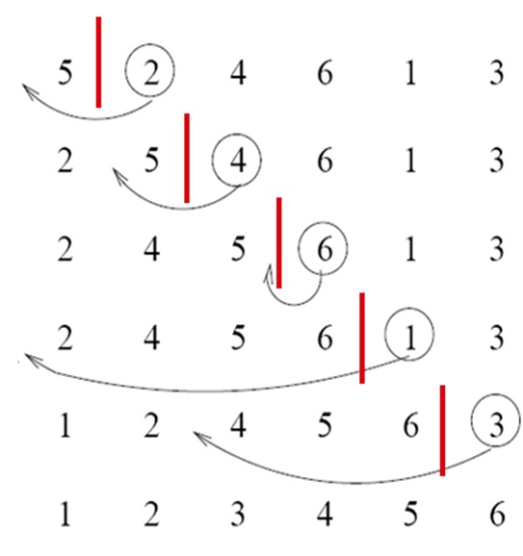
Insertion sort
Iterative algorithm
At each iteration one input element is consumed, growing a sorted output sequence
Iteration
remove one element from the input data
find the location it belongs within the sorted sequence
insert it there
Repeat until no input elements remain

Slide 12
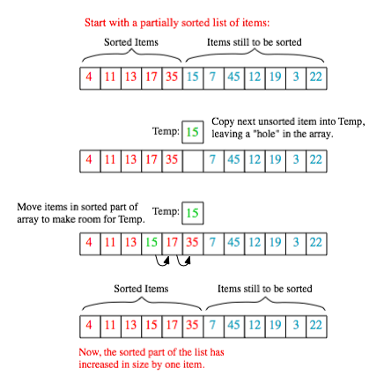
Insertion sort
Sorting is typically done in-place
For each unsorted item
shift all the larger values up to make a space
then insert it into the correct position
Notes:
at each array-position, check the value there against the largest value in the sorted list (i.e., next to it, in the previous array-position checked)
if larger, it leaves the element in place and moves to the next
if smaller, it finds the correct position within the sorted list, shifts all the larger values up to make a space, and inserts into that correct position

Slide 13
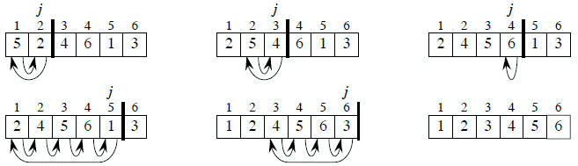
Insertion sort
Pseudo-code of the algorithm (supposing the origin of the array is 1)
FOR j = 2 to length(A)
key = A[j]
% put A[j] into the sorted sequence A[1..j-1]
i = j - 1
WHILE i > 0 and A[i] > key
A[i+1] = A[i]
i = i – 1
A[i+1] = key

Slide 14

Insertion sort
FOR j = 2 to length(A)
key = A[j]
% put A[j] into the sorted sequence A[1..j-1]
i = j - 1
WHILE i > 0 and A[i] > key
A[i+1] = A[i]
i = i – 1
A[i+1] = key
First iteration trace
j = 2
key = A[2] = 2
i = 1
i > 0 && A[i] > 2 ? YES
A[2] = A[1] $→$ A[2] = 5
i = i – 1 = 0
i > 0 && A[i] > 2 ? NO because i = 0
A[i+1] = 2 $→$ A[1] = 2

Slide 15

Insertion sort
FOR j = 2 to length(A)
key = A[j]
% put A[j] into the sorted sequence A[1..j-1]
i = j - 1
WHILE i > 0 and A[i] > key
A[i+1] = A[i]
i = i – 1
A[i+1] = key
Second iteration trace
j = 3
key = A[3] = 4
i = 2
i > 0 && A[i] > 4 ? YES
A[3] = A[2] $→$ A[3] = 5
i = i – 1 = 1
i > 0 && A[i] > 4 ? NO because 2 > 4 is false
A[i+1] = 4 $→$ A[2] = 4

Slide 16

Insertion sort
FOR j = 2 to length(A)
key = A[j]
% put A[j] into the sorted sequence A[1..j-1]
i = j - 1
WHILE i > 0 and A[i] > key
A[i+1] = A[i]
i = i – 1
A[i+1] = key
Third iteration trace
j = 4
key = A[4] = 6
i = 3
i > 0 && A[i] > 6 ? NO because 5 > 6 is false
A[i+1] = 6 $→$ A[4] = 6
… and so on …

Slide 17


Insertion sort
In each iteration the first remaining entry of the input is removed, and inserted into the result at the correct position, thus extending the result

Slide 18
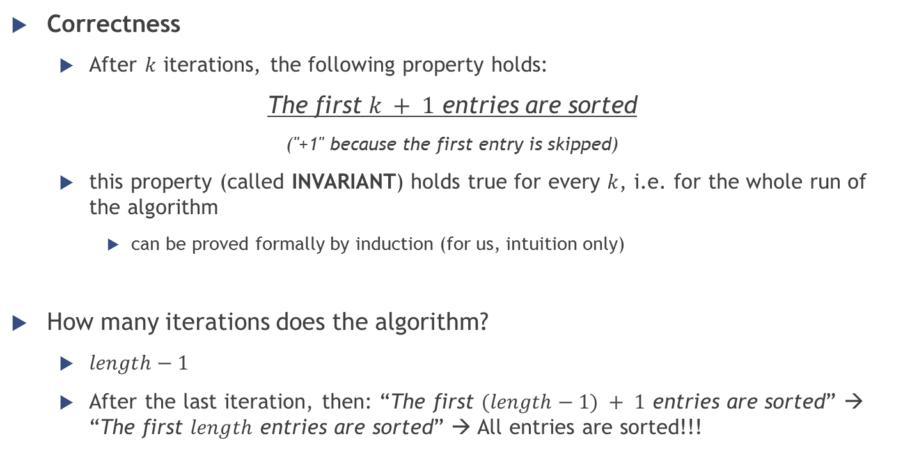
Insertion sort
Correctness
After $k$ iterations, the following property holds:
The first $k + 1$ entries are sorted
("+1" because the first entry is skipped)
this property (called INVARIANT) holds true for every $k$, i.e. for the whole run of the algorithm
can be proved formally by induction (for us, intuition only)
How many iterations does the algorithm?
$length−1$
After the last iteration, then: “The first $(length−1) + 1$ entries are sorted” → “The first $length$ entries are sorted” → All entries are sorted!!!

Slide 19


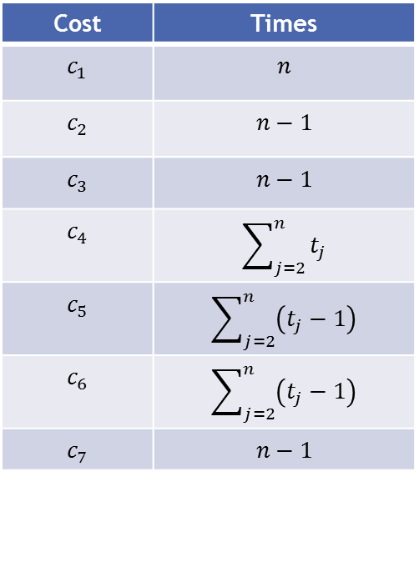
Insertion sort
Performance
Total running time = sum of all running time of all statements
If a statement takes $c_{i}$ steps to execute and is repeated $n$ times, it will contribute for $c_{i }n$
Cost | Times
$$c_{1}$$ | $$n$$
$$c_{2}$$ | $$n−1$$
$$c_{3}$$ | $$n−1$$
$$c_{4}$$ | $$\sum_{j=2}^{n}{t_{j}}$$
$$c_{5}$$ | $$\sum_{j=2}^{n}{\left(t_{j}−1\right)}$$
$$c_{6}$$ | $$\sum_{j=2}^{n}{\left(t_{j}−1\right)}$$
$$c_{7}$$ | $$n−1$$
1 FOR j = 2 to length(A)
2 key = A[j]
3 i = j - 1
4 WHILE i > 0 and A[i] > key
5 A[i+1] = A[i]
6 i = i – 1
7 A[i+1] = key
$t_{j}=$ # of times the while loop test will be executed for that particular value of $j$
Notes:
For FOR and WHILE loops which exit in the usual way (due to the condition becoming false), the test is executed one time more than the loop body (that’s why the first statement, the FOR loop test, is executed n times, while the statements inside the loop are executed n-1 times).

Slide 20

Insertion sort
$$T\left(n\right)=c_{1}n+c_{2}\left(n−1\right)+c_{3}\left(n−1\right)+c_{4}\sum_{j=2}^{n}{t_{j}}+c_{5}\sum_{j=2}^{n}{\left(t_{j}−1\right)}+c_{6}\sum_{j=2}^{n}{\left(t_{j}−1\right)}+c_{7}\left(n−1\right)$$
Cost | Times
$$c_{1}$$ | $$n$$
$$c_{2}$$ | $$n−1$$
$$c_{3}$$ | $$n−1$$
$$c_{4}$$ | $$\sum_{j=2}^{n}{t_{j}}$$
$$c_{5}$$ | $$\sum_{j=2}^{n}{\left(t_{j}−1\right)}$$
$$c_{6}$$ | $$\sum_{j=2}^{n}{\left(t_{j}−1\right)}$$
$$c_{7}$$ | $$n−1$$
1 FOR j = 2 to length(A)
2 key = A[j]
3 i = j - 1
4 WHILE i > 0 and A[i] > key
5 A[i+1] = A[i]
6 i = i – 1
7 A[i+1] = key
$t_{j}=$ # of times the while loop test will be executed for that particular value of $j$
Notes:
For FOR and WHILE loops which exit in the usual way (due to the condition becoming false), the test is executed one time more than the loop body (that’s why the first statement, the FOR loop test, is executed n times, while the statements inside the loop are executed n-1 times).

Slide 21
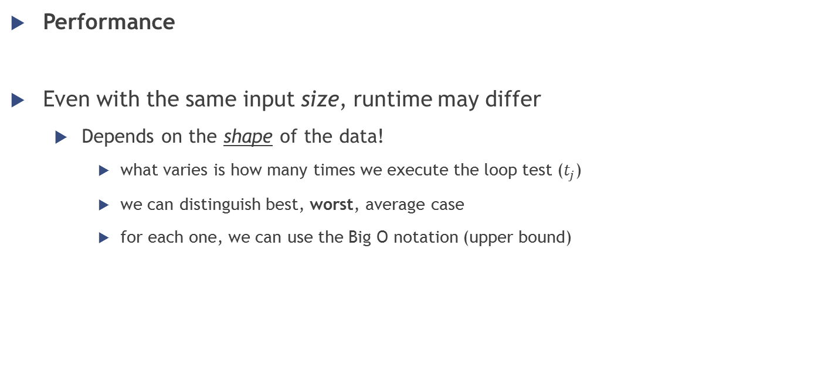
Insertion sort
Performance
Even with the same input size, runtime may differ
Depends on the shape of the data!
what varies is how many times we execute the loop test ($t_{j}$)
we can distinguish best, worst, average case
for each one, we can use the Big O notation (upper bound)

Slide 22
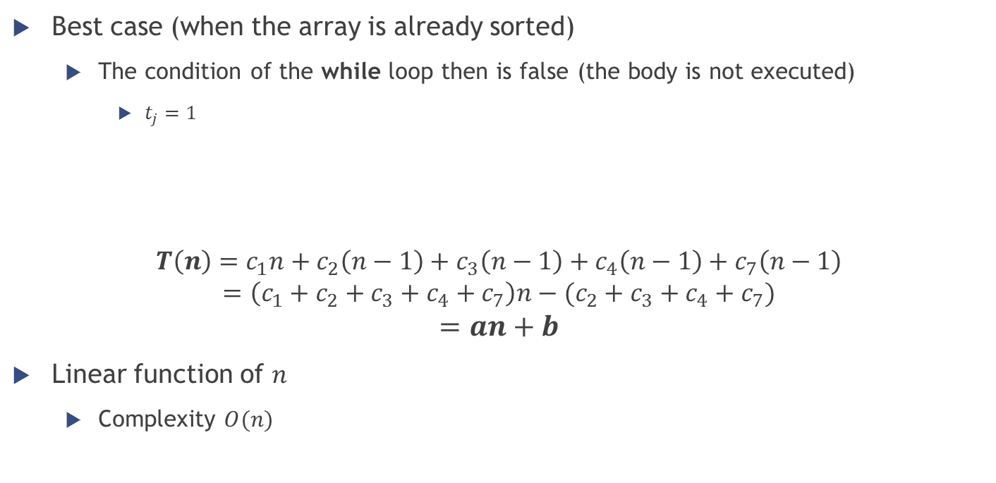
Insertion sort
FOR j = 2 to length(A)
key = A[j]
% put A[j] into the sorted sequence A[1..j-1]
i = j - 1
WHILE i > 0 and A[i] > key
A[i+1] = A[i]
i = i – 1
A[i+1] = key
Best case (when the array is already sorted)
The condition of the while loop then is false (the body is not executed)
$t_{j}=1$
$$T\left(n\right)=c_{1}n+c_{2}\left(n−1\right)+c_{3}\left(n−1\right)+c_{4}\left(n−1\right)+c_{7}\left(n−1\right)$$
$$=\left(c_{1}+c_{2}+c_{3}+c_{4}+c_{7}\right)n−(c_{2}+c_{3}+c_{4}+c_{7})$$
$$=an+b$$
Linear function of $n$
Complexity $O(n)$
$$T\left(n\right)=c_{1}n+c_{2}\left(n−1\right)+c_{3}\left(n−1\right)+c_{4}\sum_{j=2}^{n}{t_{j}}+c_{5}\sum_{j=2}^{n}{\left(t_{j}−1\right)}+c_{6}\sum_{j=2}^{n}{\left(t_{j}−1\right)}+c_{7}\left(n−1\right)$$

Slide 23
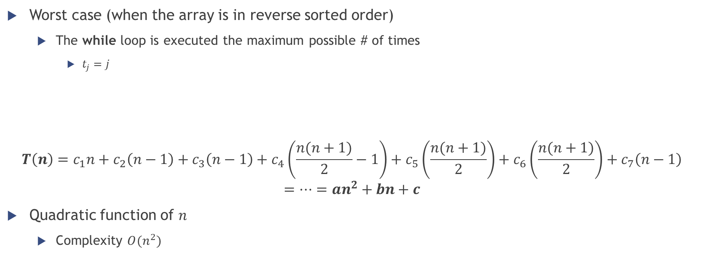
Insertion sort
FOR j = 2 to length(A)
key = A[j]
% put A[j] into the sorted sequence A[1..j-1]
i = j - 1
WHILE i > 0 and A[i] > key
A[i+1] = A[i]
i = i – 1
A[i+1] = key
Worst case (when the array is in reverse sorted order)
The while loop is executed the maximum possible # of times
$t_{j}=j$
$$T\left(n\right)=c_{1}n+c_{2}\left(n−1\right)+c_{3}\left(n−1\right)+c_{4}\left(\frac{n(n+1)}{2}−1\right)+c_{5}\left(\frac{n(n+1)}{2}\right)+c_{6}\left(\frac{n(n+1)}{2}\right)+c_{7}\left(n−1\right)$$
$$=…=an^{2}+bn+c$$
Quadratic function of $n$
Complexity $O(n^{2})$
$$T\left(n\right)=c_{1}n+c_{2}\left(n−1\right)+c_{3}\left(n−1\right)+c_{4}\sum_{j=2}^{n}{t_{j}}+c_{5}\sum_{j=2}^{n}{\left(t_{j}−1\right)}+c_{6}\sum_{j=2}^{n}{\left(t_{j}−1\right)}+c_{7}\left(n−1\right)$$

Slide 24

Insertion sort
Complexity analysis: summary
Best case → sequence already sorted
$$O(n)$$
Worst case → sequence in reverse sorted order
$$O\left(n^{2}\right)$$
3 | 5 | 6 | 9 | 11 | 15
15 | 11 | 9 | 6 | 5 | 3

Slide 25
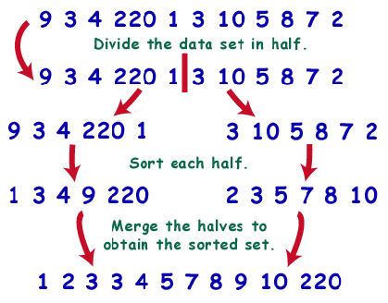
Merge sort

Slide 26
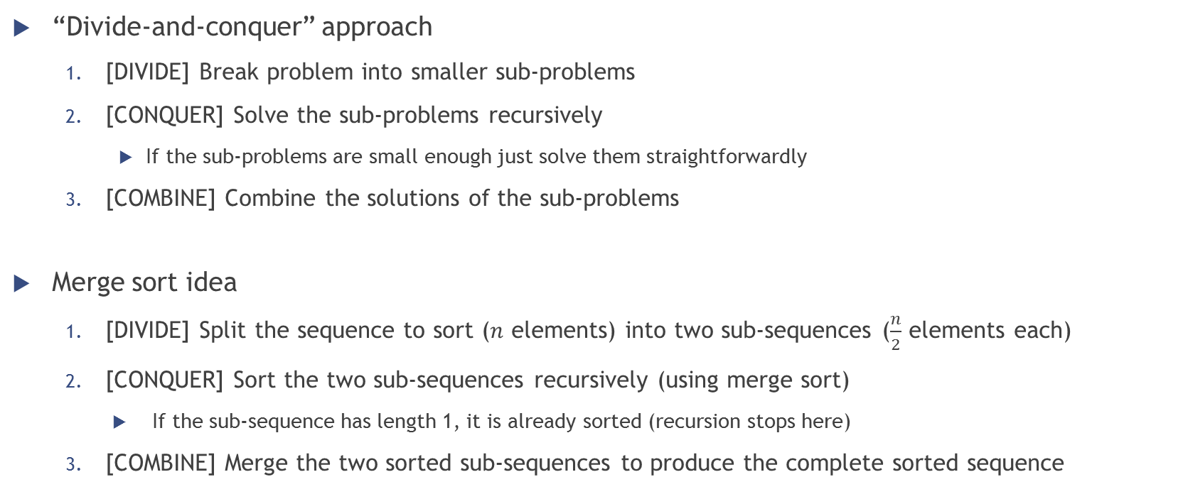
Merge sort
“Divide-and-conquer” approach
[DIVIDE] Break problem into smaller sub-problems
[CONQUER] Solve the sub-problems recursively
If the sub-problems are small enough just solve them straightforwardly
[COMBINE] Combine the solutions of the sub-problems
Merge sort idea
[DIVIDE] Split the sequence to sort ($n$ elements) into two sub-sequences ($\frac{n}{2}$ elements each)
[CONQUER] Sort the two sub-sequences recursively (using merge sort)
If the sub-sequence has length 1, it is already sorted (recursion stops here)
[COMBINE] Merge the two sorted sub-sequences to produce the complete sorted sequence

Slide 27
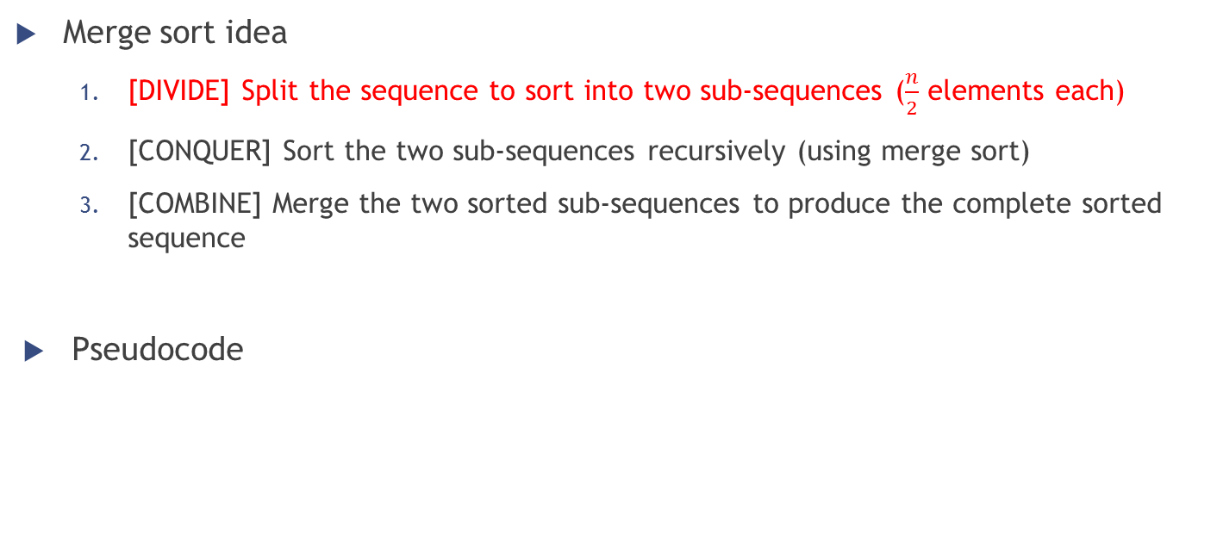
Merge sort
Merge sort idea
[DIVIDE] Split the sequence to sort into two sub-sequences ($\frac{n}{2}$ elements each)
[CONQUER] Sort the two sub-sequences recursively (using merge sort)
[COMBINE] Merge the two sorted sub-sequences to produce the complete sorted sequence
Pseudocode
MERGE-SORT(A,p,r)
if p < r
q = (p + r) / 2
MERGE-SORT(A,p,q)
MERGE-SORT(A,q+1,r)
MERGE(A,p,q,r)

Slide 28
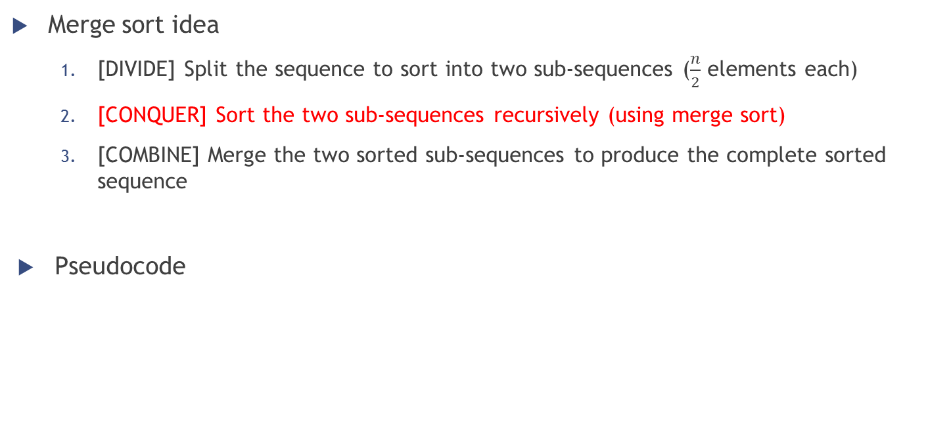
Merge sort
Merge sort idea
[DIVIDE] Split the sequence to sort into two sub-sequences ($\frac{n}{2}$ elements each)
[CONQUER] Sort the two sub-sequences recursively (using merge sort)
[COMBINE] Merge the two sorted sub-sequences to produce the complete sorted sequence
Pseudocode
MERGE-SORT(A,p,r)
if p < r
q = (p + r) / 2
MERGE-SORT(A,p,q)
MERGE-SORT(A,q+1,r)
MERGE(A,p,q,r)

Slide 29
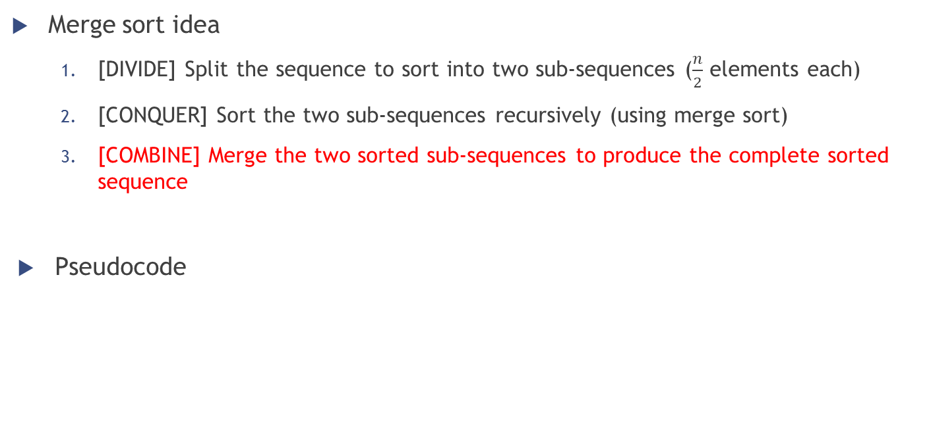
Merge sort
Merge sort idea
[DIVIDE] Split the sequence to sort into two sub-sequences ($\frac{n}{2}$ elements each)
[CONQUER] Sort the two sub-sequences recursively (using merge sort)
[COMBINE] Merge the two sorted sub-sequences to produce the complete sorted sequence
Pseudocode
MERGE-SORT(A,p,r)
if p < r
q = (p + r) / 2
MERGE-SORT(A,p,q)
MERGE-SORT(A,q+1,r)
MERGE(A,p,q,r)

Slide 30
Merge sort
How to combine two sorted sub-sequences into one?
Example
two sorted piles of cards (face-up; smallest card on top)
we want to merge them into a single sorted pile
Procedure
Choose the smallest of the two cards on top and remove it from its pile
Place this card into the output pile (face down)
Repeat the previous step until one of the two piles is empty
Take the remaining input pile and move it into the output one

Slide 31
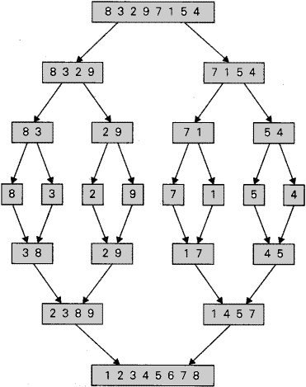
Merge sort
Example: merging the two sequences 2 3 8 9 and 1 4 5 7
Compare 2 and 1 → Put 1 into the output sequence
S1: 2 3 8 9; S2: 4 5 7; OUTPUT: 1
Compare 2 and 4 → Put 2 into the output sequence
S1: 3 8 9; S2: 4 5 7; OUTPUT: 1 2
Compare 3 and 4 → Put 3 into the output sequence
S1: 8 9; S2: 4 5 7; OUTPUT: 1 2 3
Compare 8 and 4 → Put 4 into the output sequence
S1: 8 9; S2: 5 7; OUTPUT: 1 2 3 4
…
/
9

Slide 32
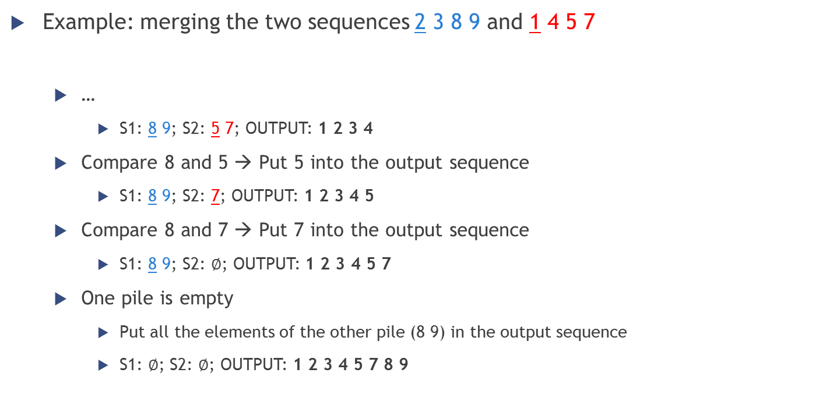
Merge sort
Example: merging the two sequences 2 3 8 9 and 1 4 5 7
…
S1: 8 9; S2: 5 7; OUTPUT: 1 2 3 4
Compare 8 and 5 → Put 5 into the output sequence
S1: 8 9; S2: 7; OUTPUT: 1 2 3 4 5
Compare 8 and 7 → Put 7 into the output sequence
S1: 8 9; S2: $∅$; OUTPUT: 1 2 3 4 5 7
One pile is empty
Put all the elements of the other pile (8 9) in the output sequence
S1: $∅$; S2: $∅$; OUTPUT: 1 2 3 4 5 7 8 9
/
9

Slide 33
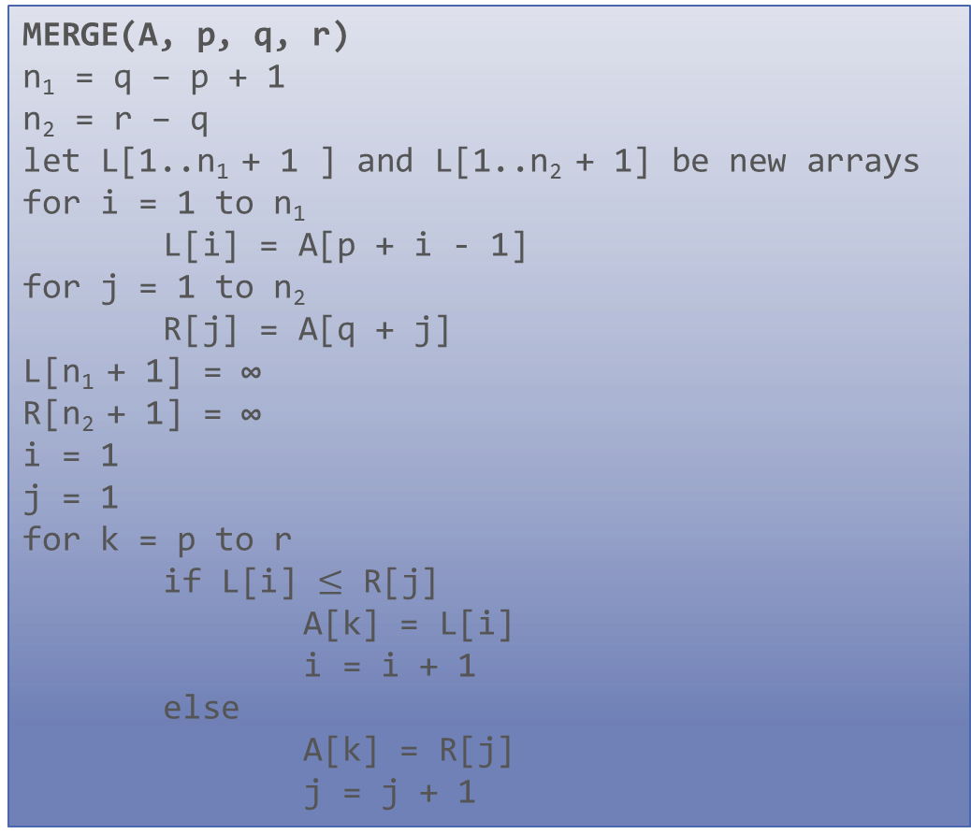
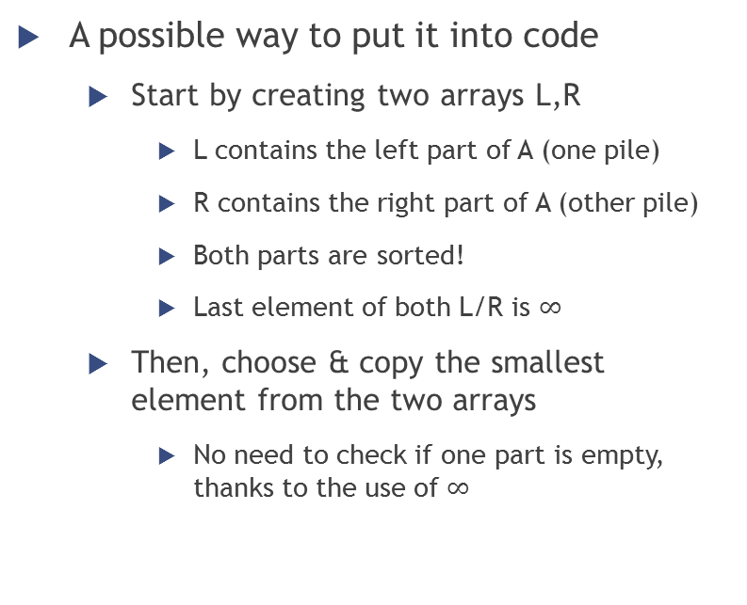
Merge sort
MERGE(A, p, q, r)
n₁ = q – p + 1
n₂ = r – q
let L[1..n₁ + 1 ] and L[1..n₂ + 1] be new arrays
for i = 1 to n₁
L[i] = A[p + i - 1]
for j = 1 to n₂
R[j] = A[q + j]
L[n₁ + 1] = ∞
R[n₂ + 1] = ∞
i = 1
j = 1
for k = p to r
if L[i] $≤$ R[j]
A[k] = L[i]
i = i + 1
else
A[k] = R[j]
j = j + 1
A possible way to put it into code
Start by creating two arrays L,R
L contains the left part of A (one pile)
R contains the right part of A (other pile)
Both parts are sorted!
Last element of both L/R is $∞$
Then, choose & copy the smallest element from the two arrays
No need to check if one part is empty, thanks to the use of $∞$

Slide 34
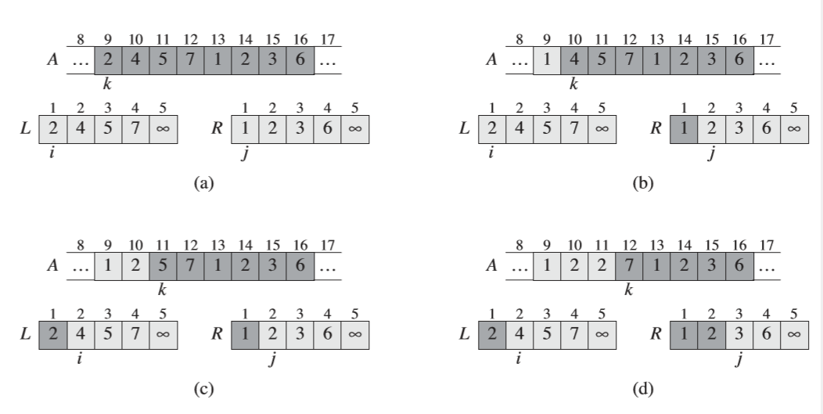
Merge sort

Slide 35
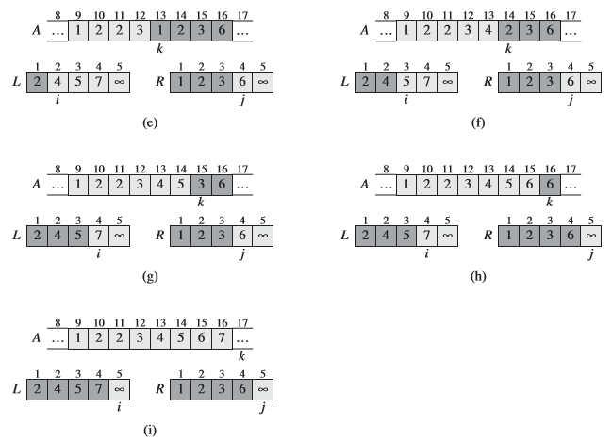
Merge sort

Slide 36
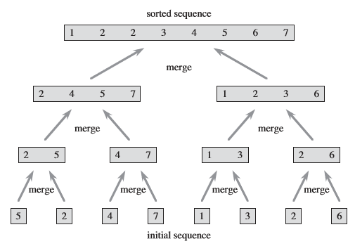
Merge sort

Slide 37
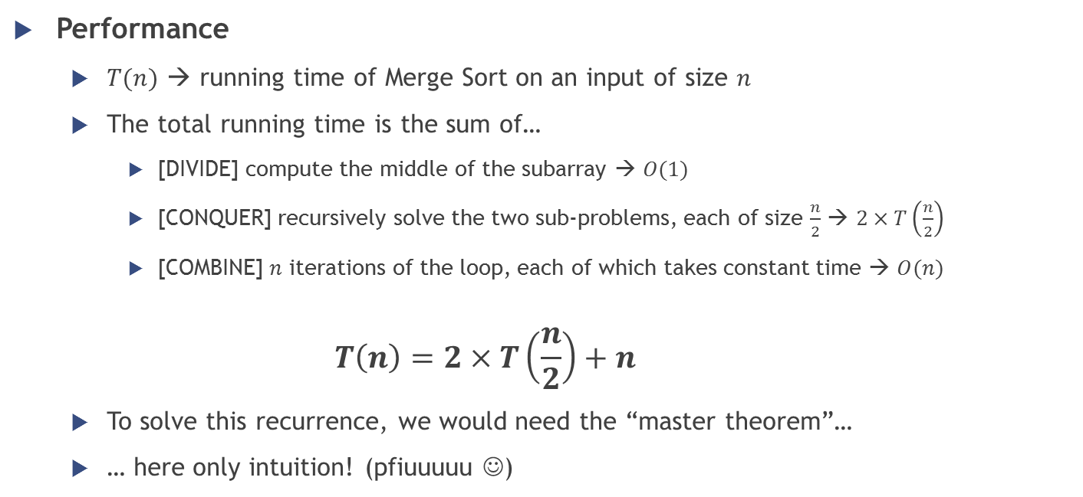
Merge sort
Performance
$T(n)$ → running time of Merge Sort on an input of size $n$
The total running time is the sum of…
[DIVIDE] compute the middle of the subarray → $O(1)$
[CONQUER] recursively solve the two sub-problems, each of size $\frac{n}{2}$ → $2×T\left(\frac{n}{2}\right)$
[COMBINE] $n$ iterations of the loop, each of which takes constant time → $O(n)$
$$T\left(n\right)=2×T\left(\frac{n}{2}\right)+n$$
To solve this recurrence, we would need the “master theorem”…
… here only intuition! (pfiuuuuu ☺)

Slide 38
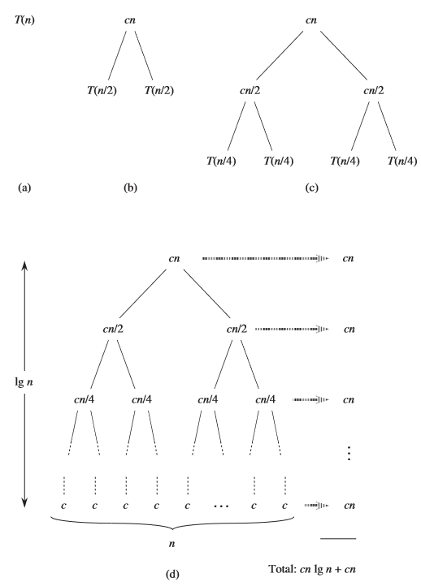
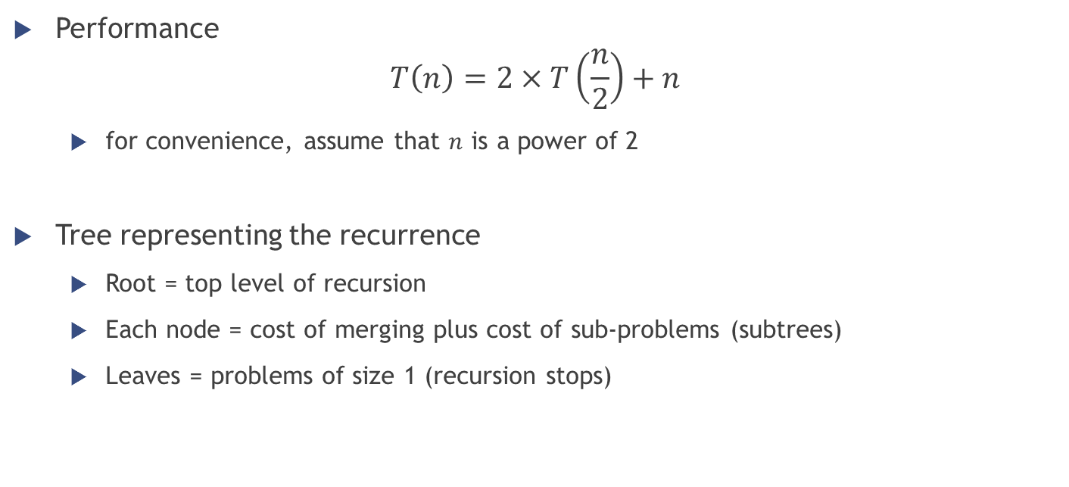
Merge sort
Performance
$$T\left(n\right)=2×T\left(\frac{n}{2}\right)+n$$
for convenience, assume that $n$ is a power of 2
Tree representing the recurrence
Root = top level of recursion
Each node = cost of merging plus cost of sub-problems (subtrees)
Leaves = problems of size 1 (recursion stops)

Slide 39
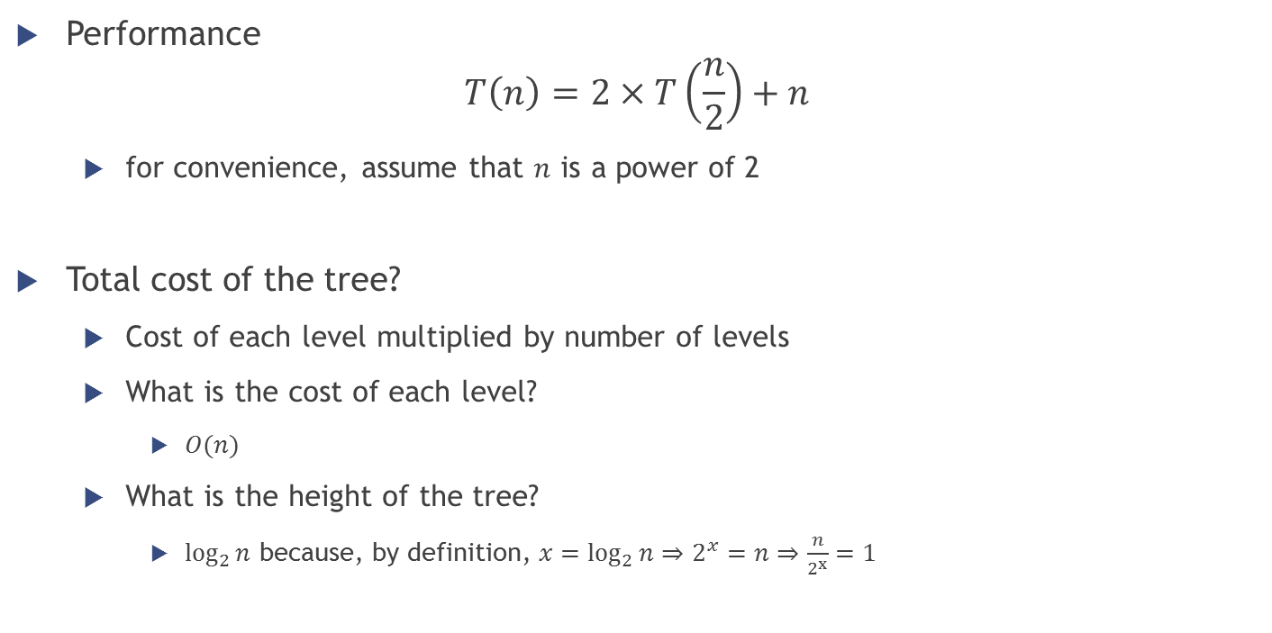
Merge sort
Performance
$$T\left(n\right)=2×T\left(\frac{n}{2}\right)+n$$
for convenience, assume that $n$ is a power of 2
Total cost of the tree?
Cost of each level multiplied by number of levels
What is the cost of each level?
$O(n)$
What is the height of the tree?
$\log_{2}{n}$ because, by definition, $x=\log_{2}{n}⇒2^{x}=n⇒\frac{n}{2^{x}}=1$

Slide 40
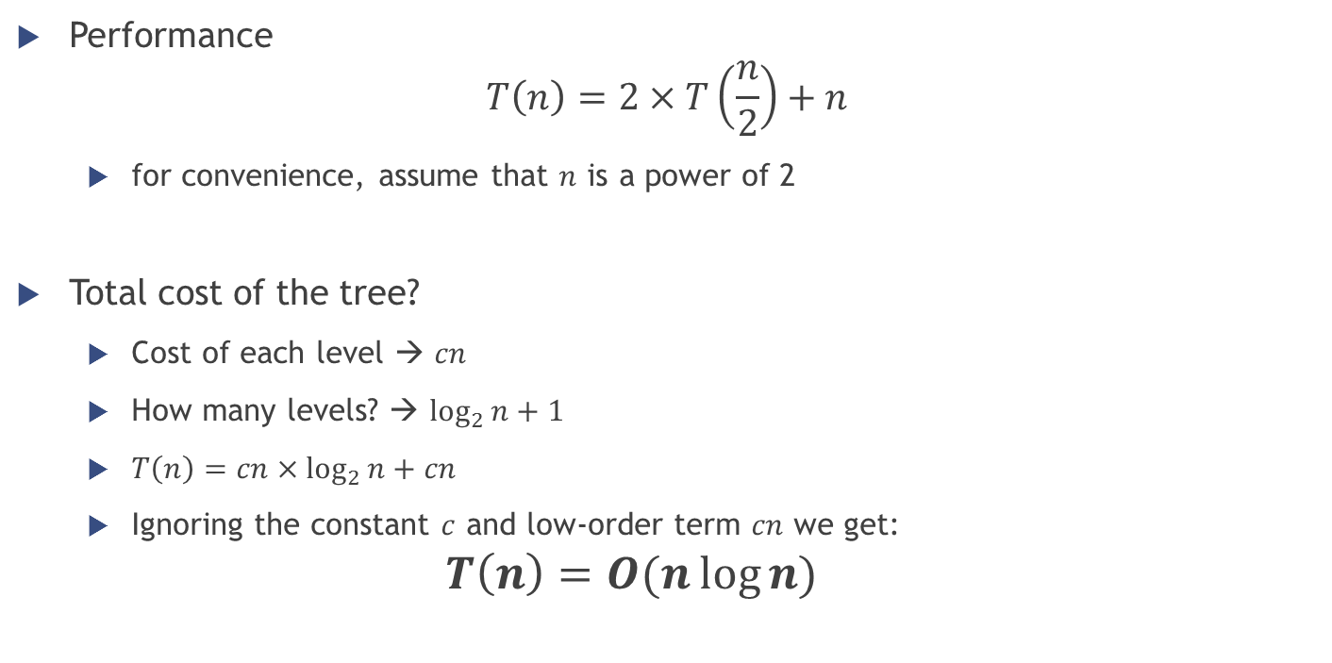
Merge sort
Performance
$$T\left(n\right)=2×T\left(\frac{n}{2}\right)+n$$
for convenience, assume that $n$ is a power of 2
Total cost of the tree?
Cost of each level → $cn$
How many levels? → $\log_{2}{n}+1$
$T\left(n\right)=cn×\log_{2}{n}+cn$
Ignoring the constant $c$ and low-order term $cn$ we get:
$$T\left(n\right)=O(n\log{n})$$

Slide 41
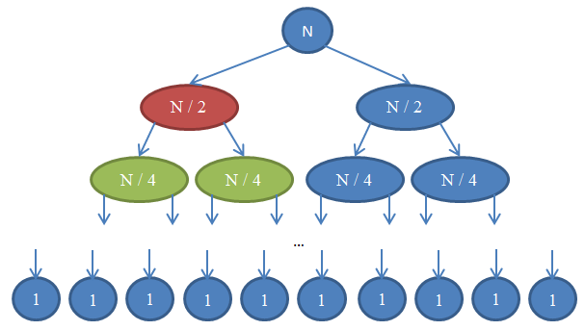
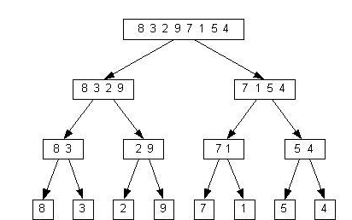
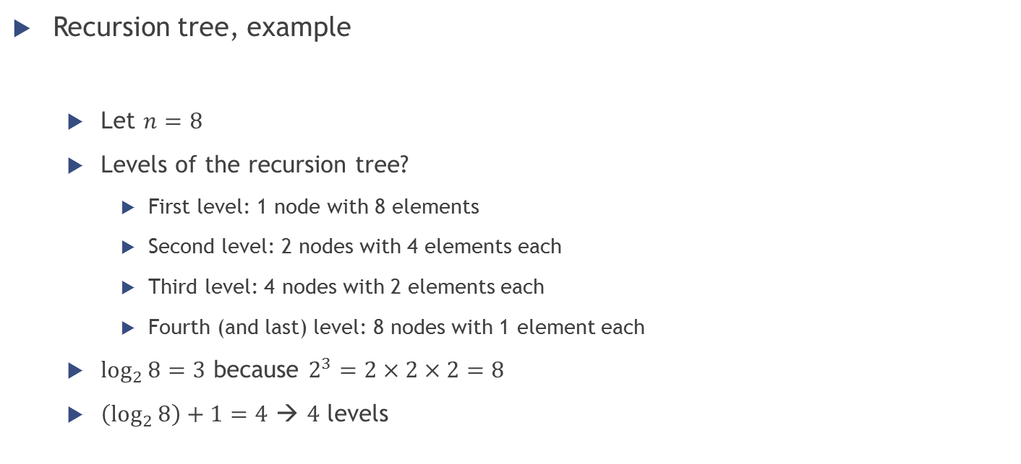
Merge sort
Recursion tree, example
Let $n=8$
Levels of the recursion tree?
First level: 1 node with 8 elements
Second level: 2 nodes with 4 elements each
Third level: 4 nodes with 2 elements each
Fourth (and last) level: 8 nodes with 1 element each
$\log_{2}{8}=3$ because $2^{3}=2×2×2=8$
$\left(\log_{2}{8}\right)+1=4$ → $4$ levels

Slide 42
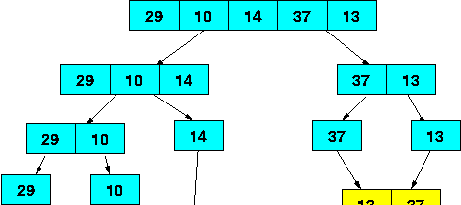
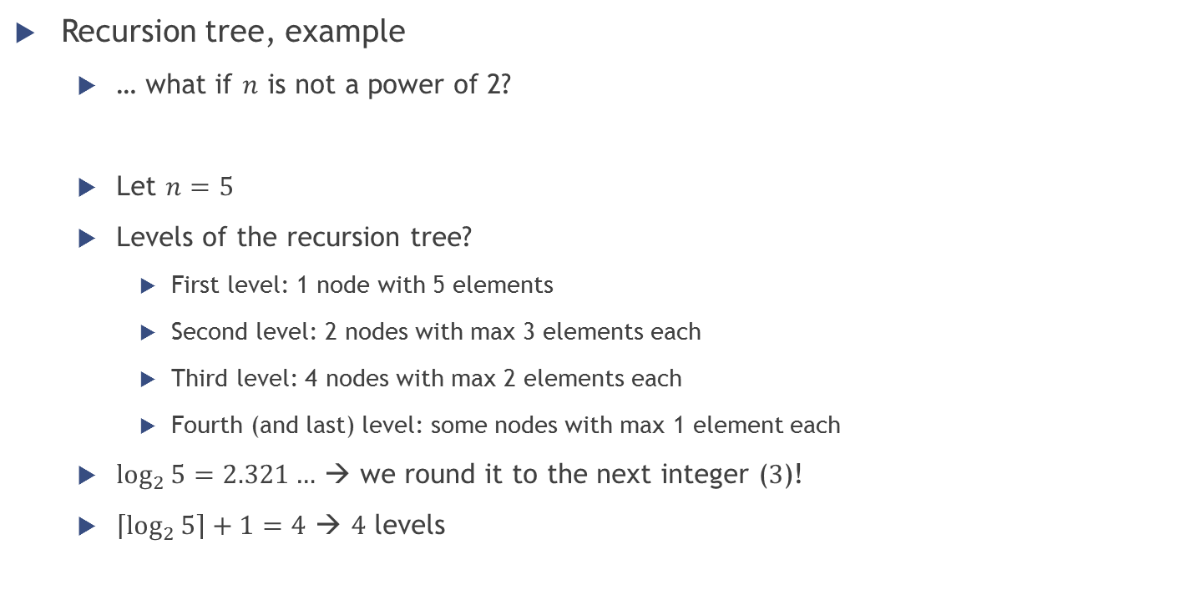
Merge sort
Recursion tree, example
… what if $n$ is not a power of 2?
Let $n=5$
Levels of the recursion tree?
First level: 1 node with 5 elements
Second level: 2 nodes with max 3 elements each
Third level: 4 nodes with max 2 elements each
Fourth (and last) level: some nodes with max 1 element each
$\log_{2}{5}{=2.321…}$ → we round it to the next integer ($3$)!
$\left\lceil \log_{2}{5}\right\rceil +1=4$ → $4$ levels

Slide 43
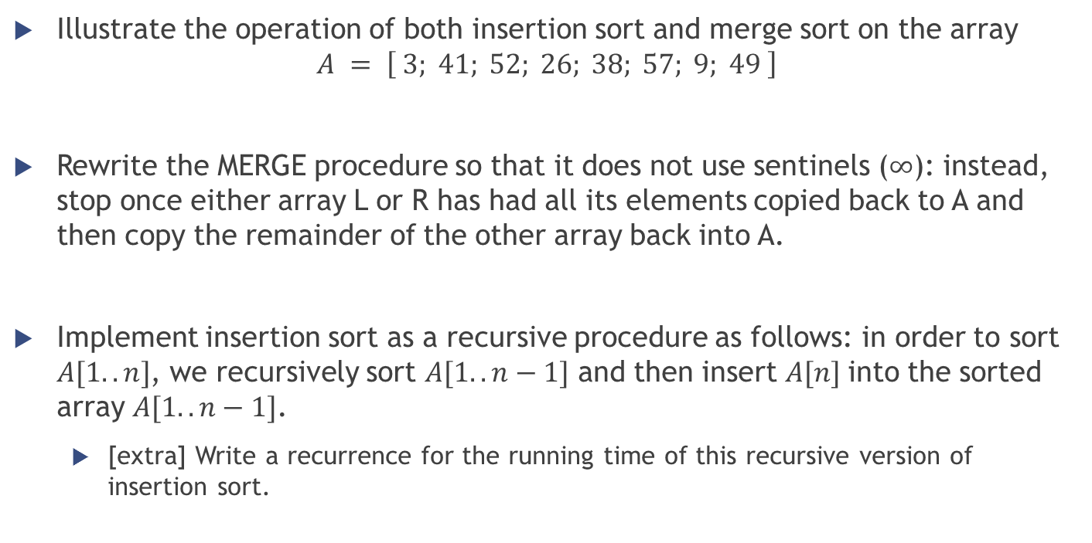
Exercises [Cormen]
Illustrate the operation of both insertion sort and merge sort on the array
$$A = \left[ 3; 41; 52; 26; 38; 57; 9; 49 \right]$$
Rewrite the MERGE procedure so that it does not use sentinels ($∞$): instead, stop once either array L or R has had all its elements copied back to A and then copy the remainder of the other array back into A.
Implement insertion sort as a recursive procedure as follows: in order to sort $A[1..n]$, we recursively sort $A[1..n−1]$ and then insert $A[n]$into the sorted array $A[1..n−1]$.
[extra] Write a recurrence for the running time of this recursive version of insertion sort.

Slide 44
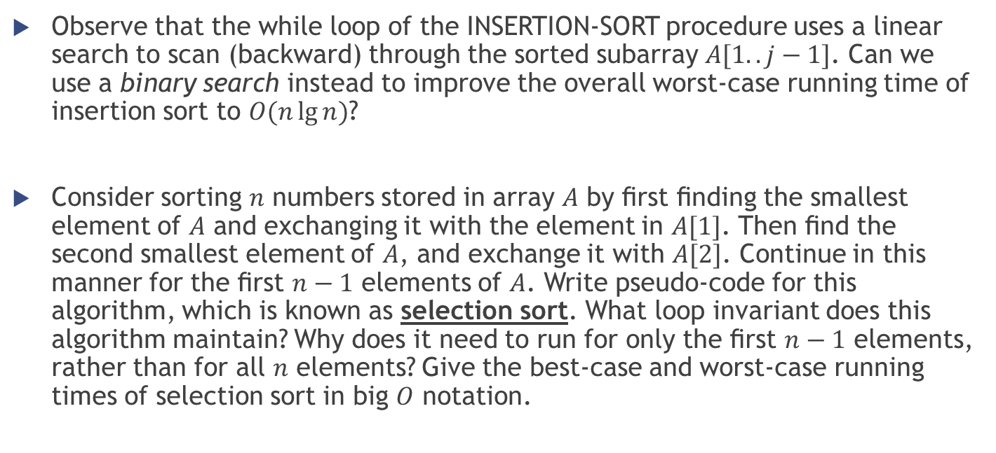
Exercises [Cormen]
Observe that the while loop of the INSERTION-SORT procedure uses a linear search to scan (backward) through the sorted subarray $A[1..j−1]$. Can we use a binary search instead to improve the overall worst-case running time of insertion sort to $O(n\lg{n})$?
Consider sorting $n$ numbers stored in array $A$ by ﬁrst ﬁnding the smallest element of $A$ and exchanging it with the element in $A[1]$. Then ﬁnd the second smallest element of $A$, and exchange it with $A[2]$. Continue in this manner for the ﬁrst $n−1$ elements of $A$. Write pseudo-code for this algorithm, which is known as selection sort. What loop invariant does this algorithm maintain? Why does it need to run for only the ﬁrst $n−1$ elements, rather than for all $n$ elements? Give the best-case and worst-case running times of selection sort in big $O$ notation.

Slide 45
Exercises [Schaum]
Questions
14.15 14.16 [referred only to insertion&merge sort]
Problems
14.1; 14.2; 14.3; 14.6; 14.11 [only for insertion&merge sort]; 14.21

